Slide 1
Natural Language Processing

Slide 2
Sequence data
Speech recognition

Slide 3
Sequence data
Speech recognition
Music generation

Slide 4
Sequence data
Speech recognition
Music generation
Sentiment classification

Slide 5
Sequence data
Speech recognition
Music generation
Sentiment classification
DNA sequence analysis

Slide 6
Sequence data
Speech recognition
Music generation
Sentiment classification
DNA sequence analysis
Machine translation

Slide 7
Sequence data
Speech recognition
Music generation
Sentiment classification
DNA sequence analysis
Machine translation
Video activity recognition

Slide 8
Sequence data
Speech recognition
Music generation
Sentiment classification
DNA sequence analysis
Machine translation
Video activity recognition
Name entity recognition

Slide 9
Representing words
Vocabulary: Kolom vector met woorden
One hot vector representation

Slide 10
Waarom geen normaal neural network
Inputs & Outputs kunnen van verschillende lengtes zijn
Leert niks van woorden eerder of later in de zin

Slide 11
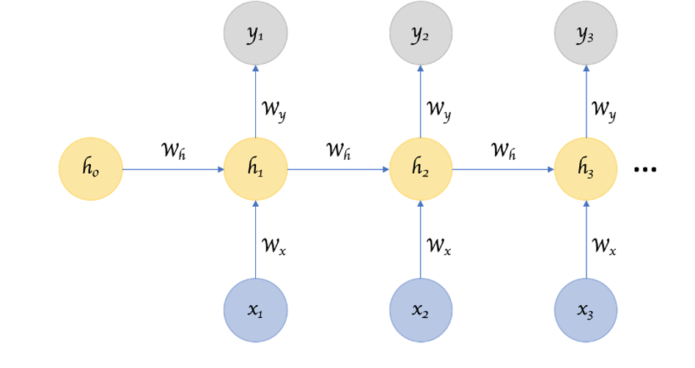
Recurrent Neural Network
Temporal information
Geheugen & Context
Vergeetachtig op de lange termijn
Welke activation function?

Slide 12
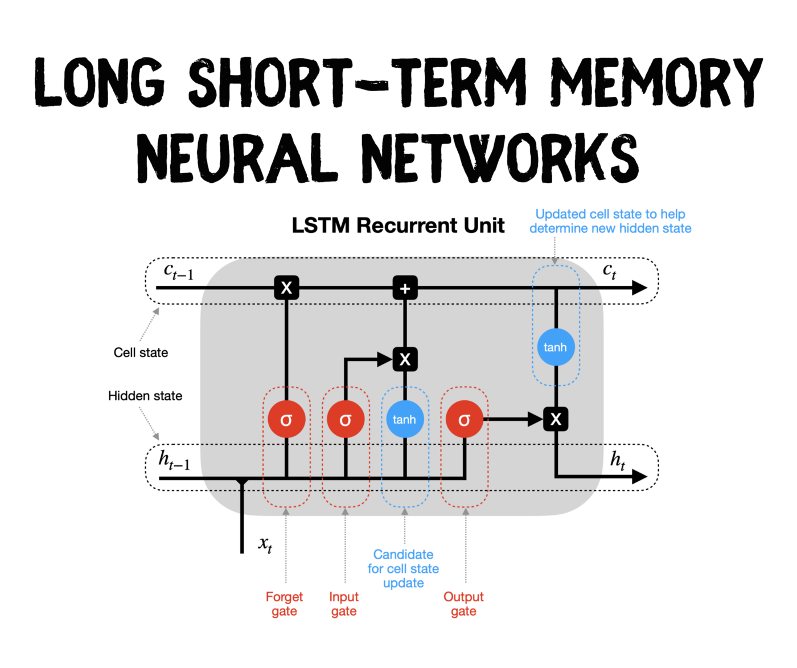
GRU, LSTM & Vanishing gradients

Slide 13
Verschillende soorten problemen
Many to Many: Name entity recognition
Many to One: Sentiment classification
One to Many: Music generation
Many to many: Machine Translation
Encoder Decoder

Slide 14
Word embeddings
One hot representation
Man Vrouw Koning Koningin Appel Orange

Slide 15
Word embeddings
Word embeddings
Man Vrouw Koning Koningin Appel Sinaasappel
Gender
Adel
Leeftijd
Eten
etc

Slide 16
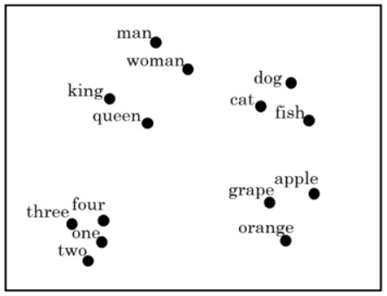
Word embeddings
Plotten in 2D

Slide 17
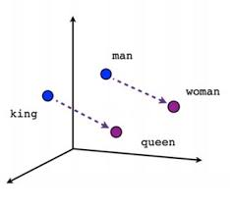
Word embeddings
Plotten in 2D

Slide 18
Word embeddings
Andere analogieën
Man:Vrouw > Jongen:??
Amsterdam:Nederland > Tokyo:??
Groot:Groter > Klein:??
Dollar:Amerika > Pond:??

Slide 19
Transfer learning in NLP
Het gebruiken van word embeddings uit hele grote datasets: tot wel 100 miljard woorden
Transfer learning met deze embeddings in een veel kleinere dataset

Slide 20
Transformers
RNN, GRU & LSTM: ingewikkelder, robuust(er) tegen vanishing gradients. Maar allemaal nog steeds sequentieel
Attention based-models: sequenties bekijken in parallel.
Self-attention

Slide 21
Self-attention
Frank visits Greece in October

Slide 22
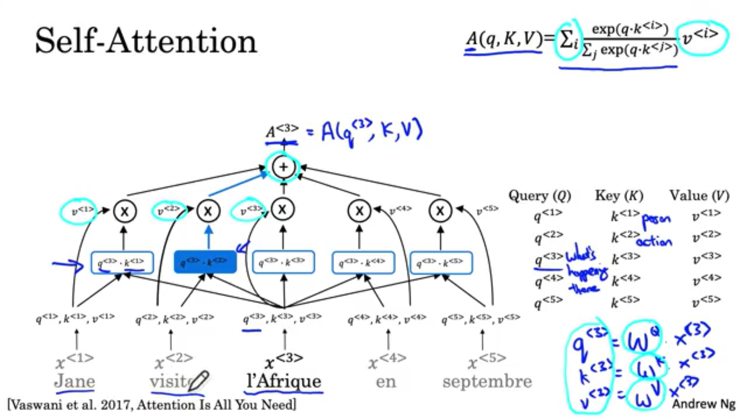

Slide 23
Transformers
Self-Attention -> Multi-head Attention
Geen fixed word embedding, maar met context
BERT: Bidirectional Encoder Representations from Transformers
GPT: Generative Pre-trained Transformer
https://arxiv.org/pdf/1706.03762.pdf

